Slide 1

HPC Monitor System Development
Group Members：
12212921 施米乐
12212614 吴宇贤
12212910 王宇航
Date：2024-12-26
Advisors:
计算机科学与工程系 李卓钊
超算中心 杨期垚
超算中心 范靖
超算中心 李恒通

Slide 2

1
研究背景
research background

Slide 3
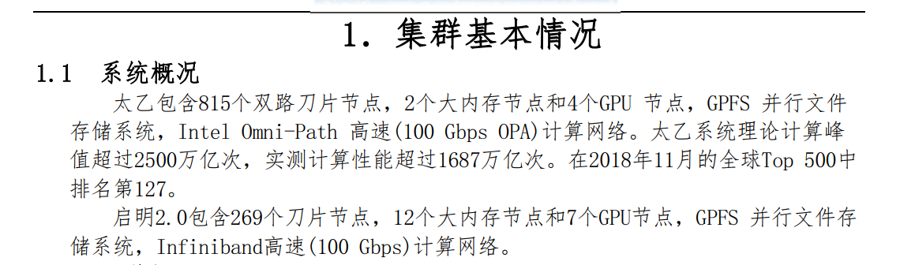
1.1
Reserach Background
The Scientific and Engineering Computing Center (https://hpc.sustech.edu.cn/) is responsible for managing and operating more than 1,100 servers on the SUSTech high-performance computing platform.
Due to the rapid growth in scale, building a cluster software and hardware monitoring and alerting system is crucial.

Slide 4
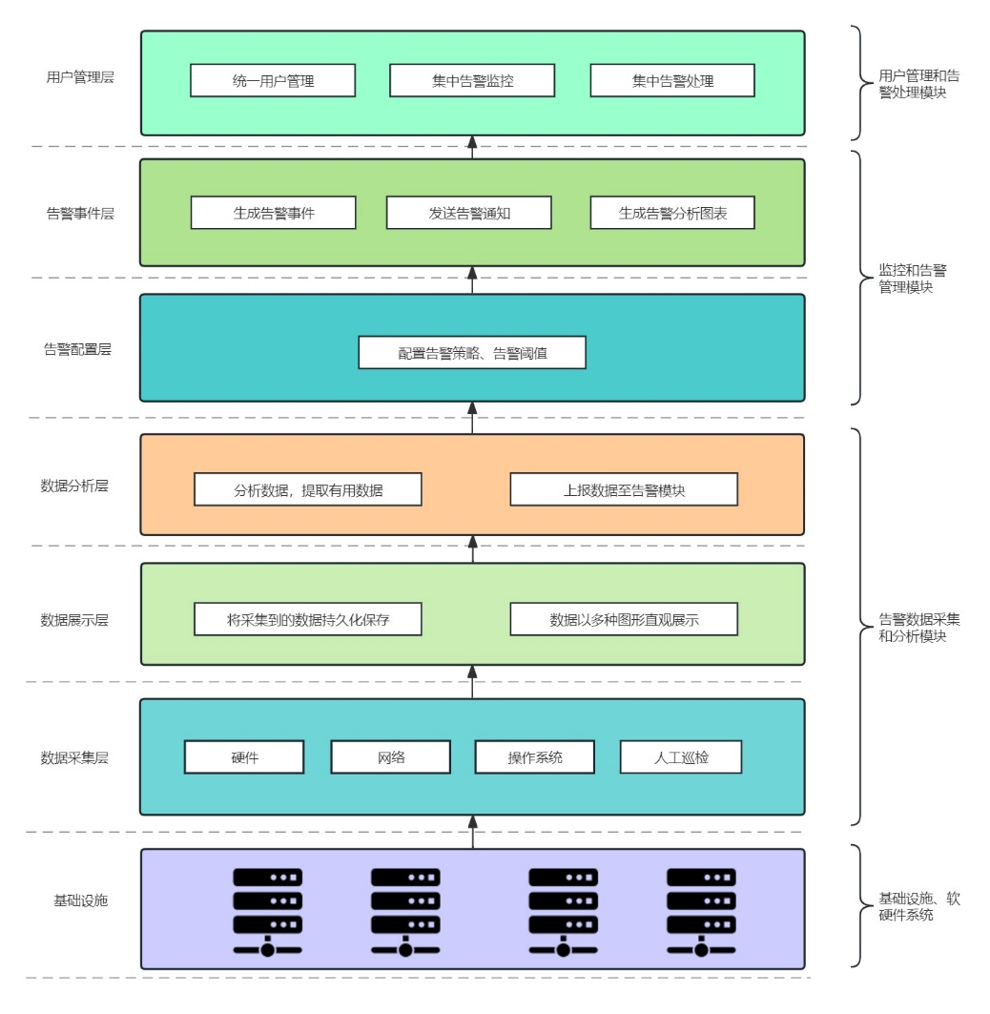
1.2
Our Goal
A system to monitor multiple high-performance computing clusters in SUSTech.
Based on Prometheus monitor, including components like Node Exporter and Alertmanager.
Using Java SpringBoot, Mybatis, Mysql, Docker tools to help develop.
Automatically generate and manage alerts according to server metrics

Slide 5
1.3
Our Work
Based on existing work.
Still have innovations and a lot works to do, including
an RBAC Permission system
further exploration on Prometheus monitor, Node exorter, and Alertmanager
Refractor most of existing code
Deployed on testing cluster and works well

Slide 6
2
项目总览
Overview

Slide 7
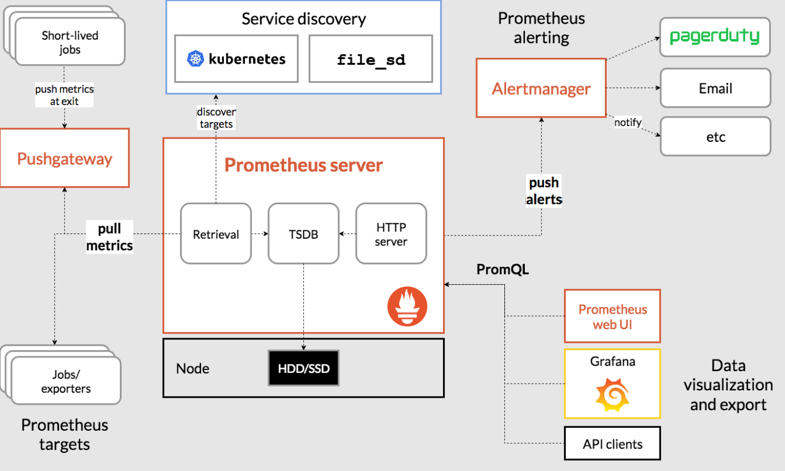
2.1
Architecture

Slide 8
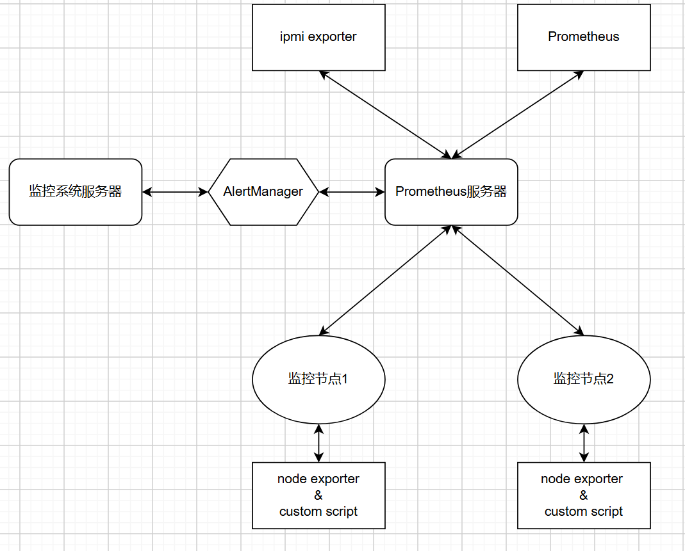
2.1
Architecture
Three main types of servers
main server
run our Java web application
Prometheus server
run Prometheus monitor
pull metrics from exproters
trigger alerts and push them to alertmaneger
Compute nodes
nodes that need monitor
run exporters and scripts
expose metrics to HTTP endpoint

Slide 9
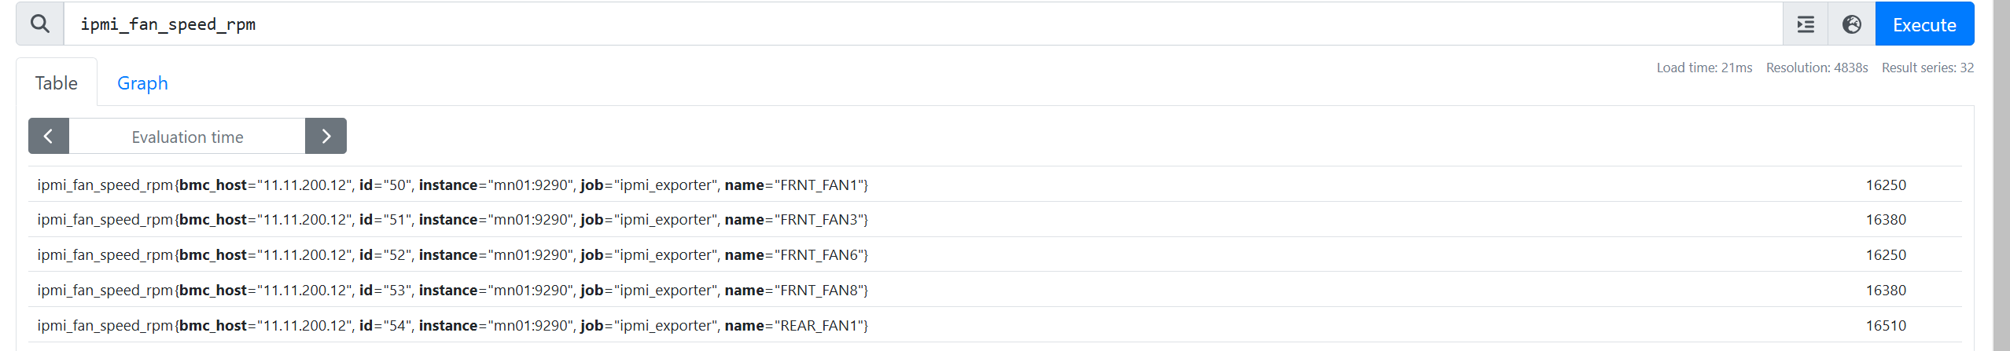
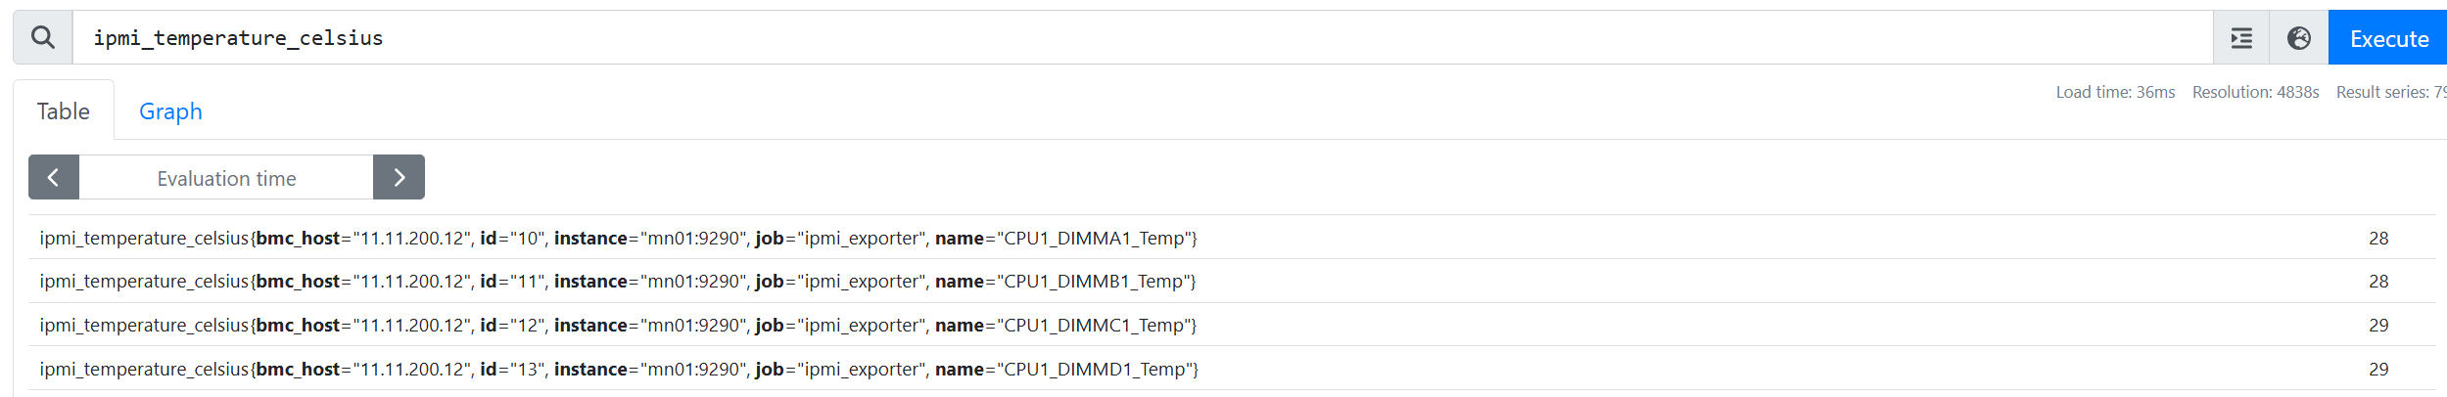
2.2
What metrics do we collect?
Hardware-level Metrics
exposed by IPMI Exporter, scraped from BMC servers (Baseboard management controller)
like fan speed, cpu temperature and power state.

Slide 10
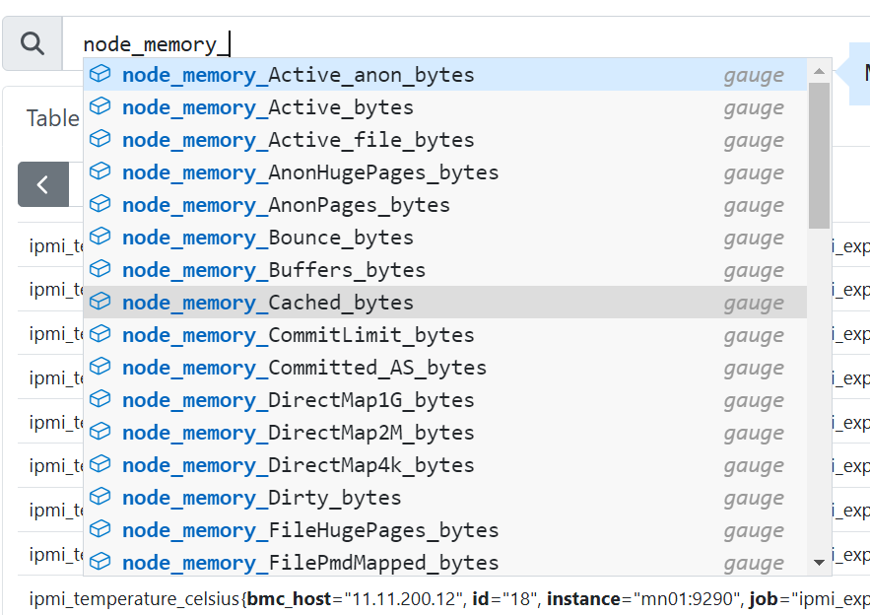
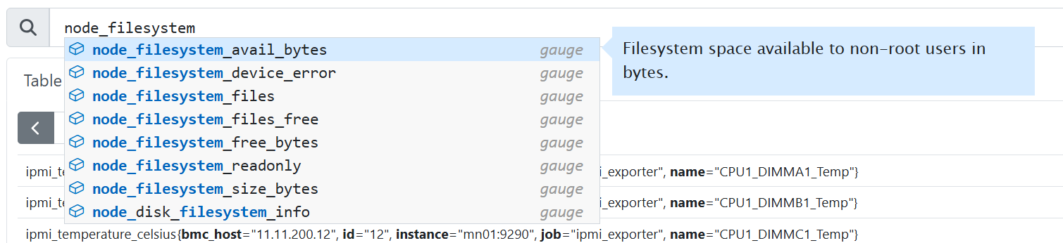
2.2
What metrics do we collect?
Software-level Metrics
exposed by Node Exporter, scrape from OS
like cpu, gpu, memeory and file system usage

Slide 11
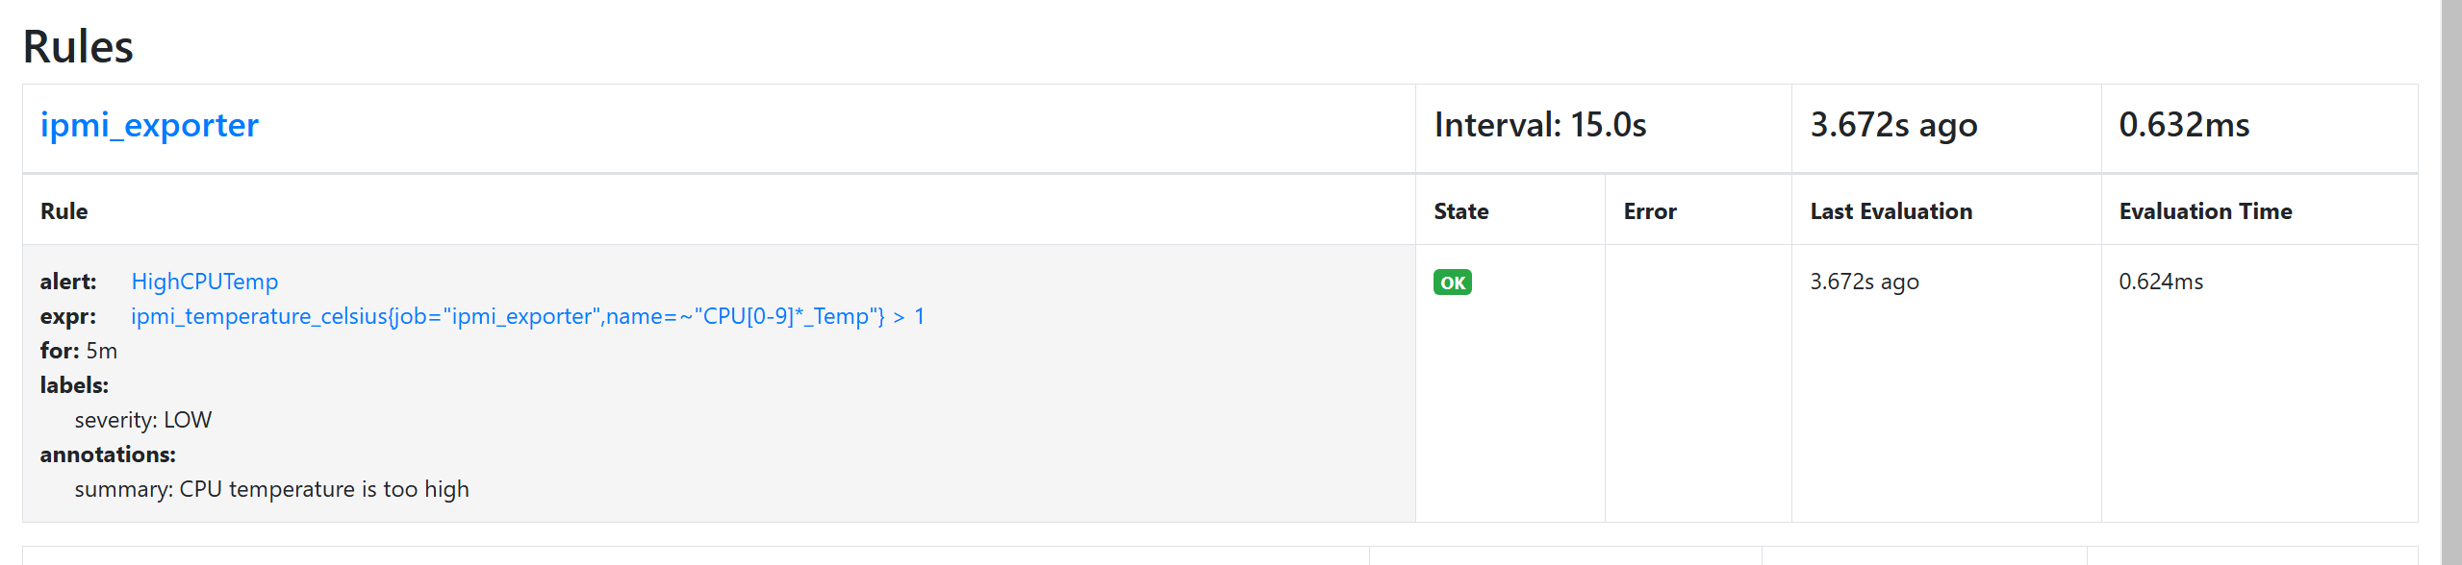
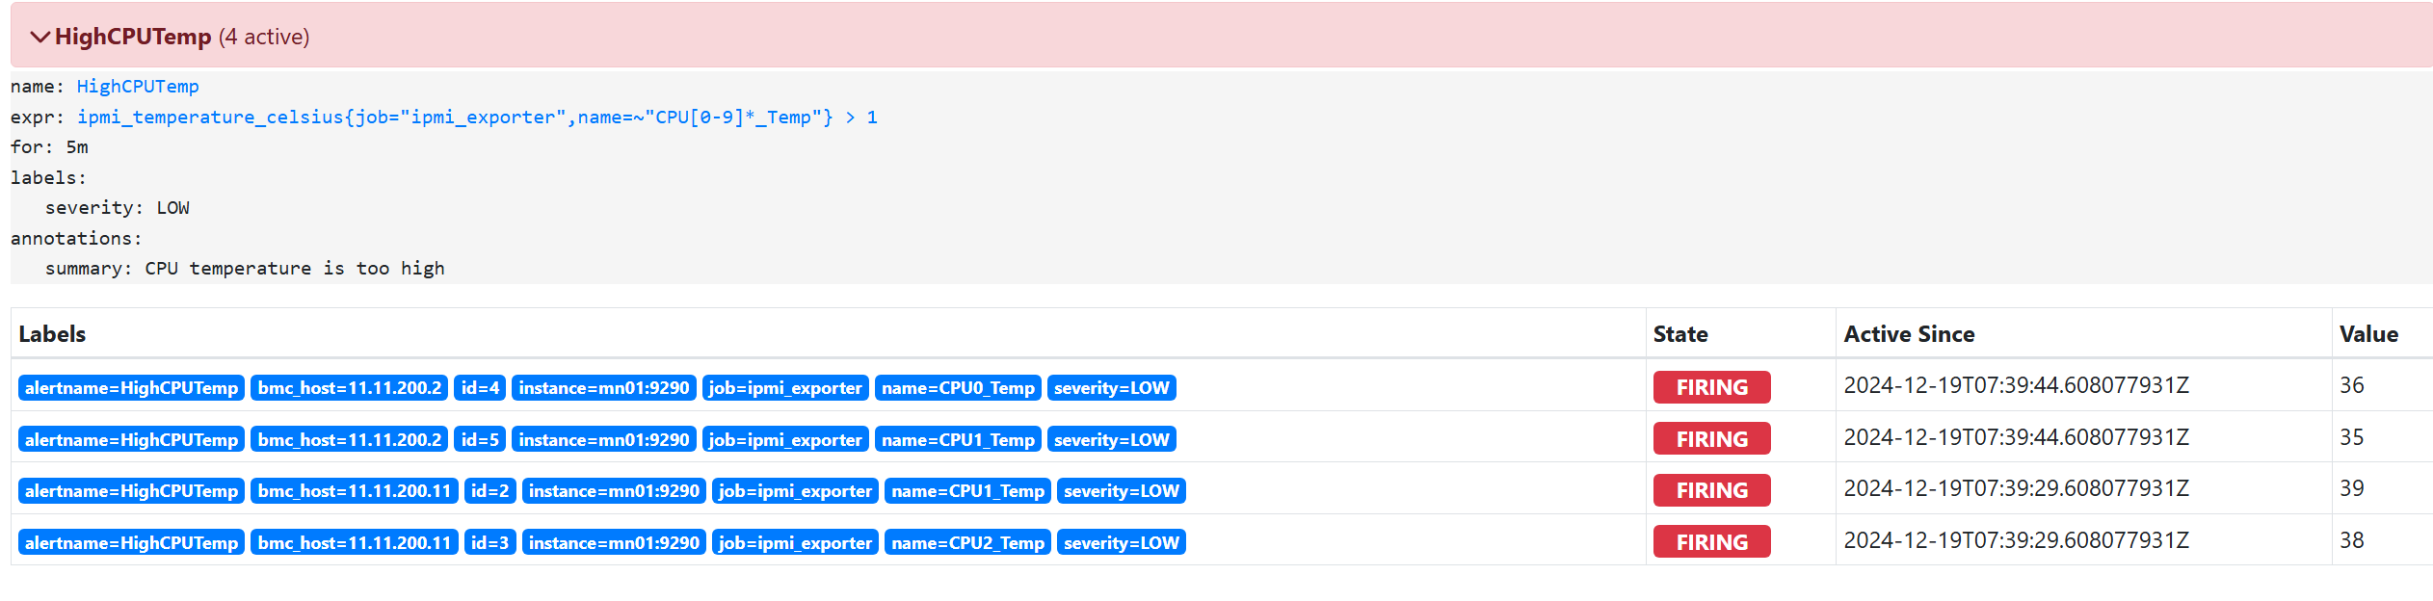
2.3
How to generate alerts?
1. Use PromQL to set alerting rules
2. Alerts will be triggered autimatically by periodical scraped metrics

Slide 12
3
问题与调研
Issue & Solution

Slide 13
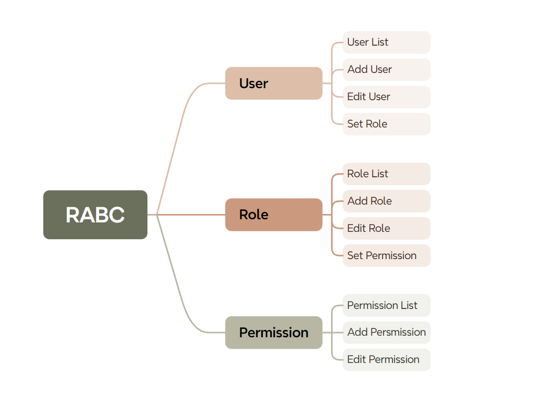
3.1
Issues & Solutions
Issue:
Lack of permission management
every user can change alerting rule or targets, and view sensitive metrics
Solution
Introduction of RBAC

Slide 14
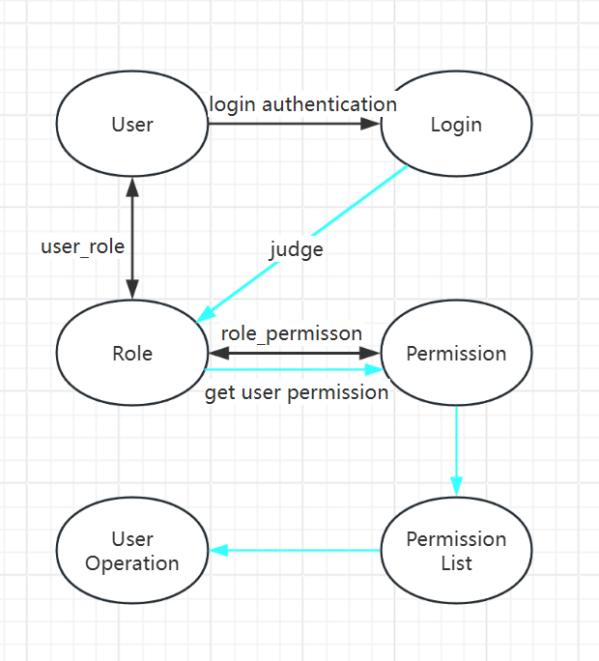
Role-based access control(RBAC)

Slide 15
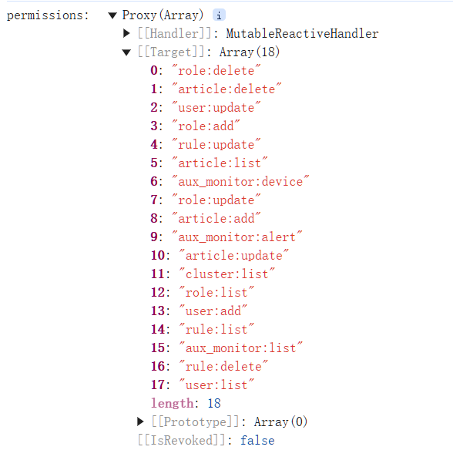
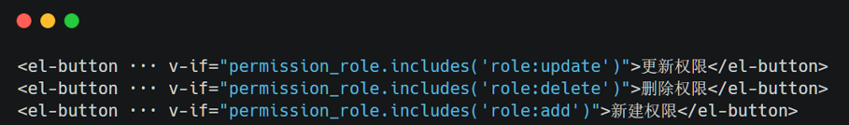
Role-based access control(RBAC)
· when we click any page, we’ll check whether this user
has the permission to operate this page
· The judgment of the front-end call

Slide 16
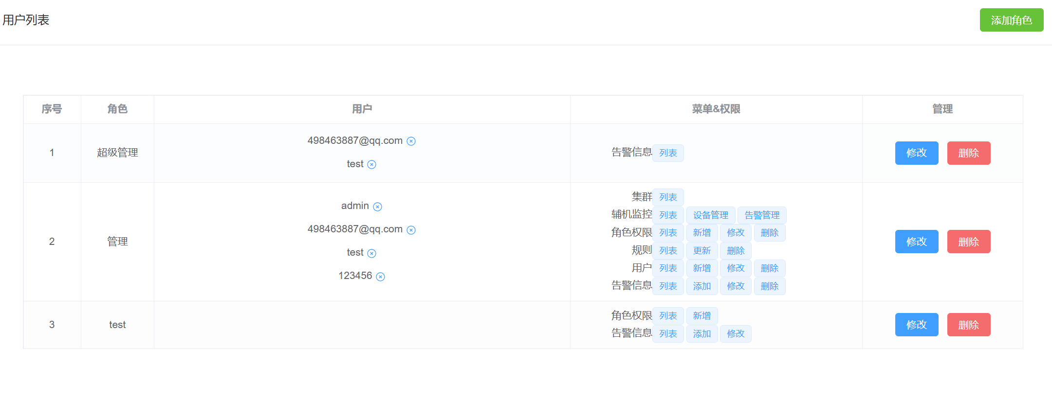
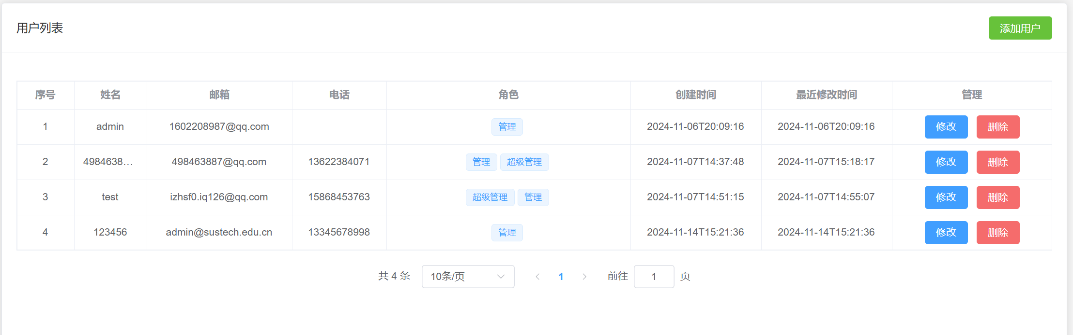
Role-based access control(RBAC)

Slide 17
3.1
Issues & Solutions
Issue
Need of software-level metrics collection
Only BMC metrics get exposed, OS-level metrics are omitted
Solution
Use Node Exporter and custom scripts

Slide 18
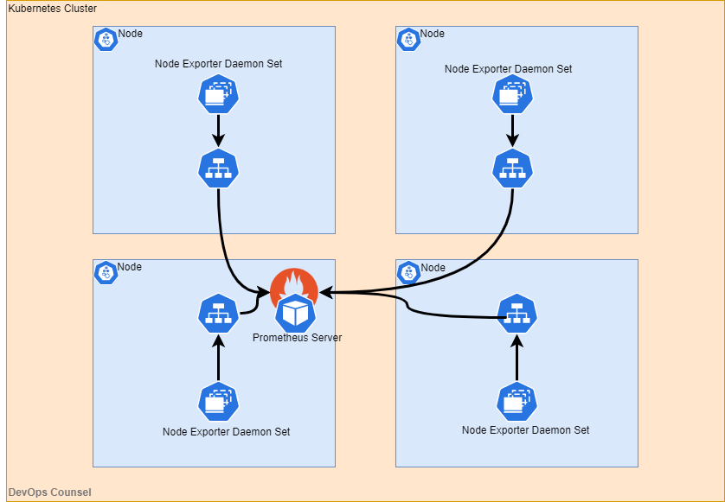
Node Exporter
An open-source component of Prometheus by community
use Node Exporter to scrape software-level metrics
deployed on every compute node and aggregate in Prometheus
utilize TextCollector to scrape custom metrics, including GPU and User details.

Slide 19
3.1
Issues & Solutions
Issue
Incompleteness of Alerts management and classification
Duplicate alerts exist
Solution
Use Alertmanager

Slide 20
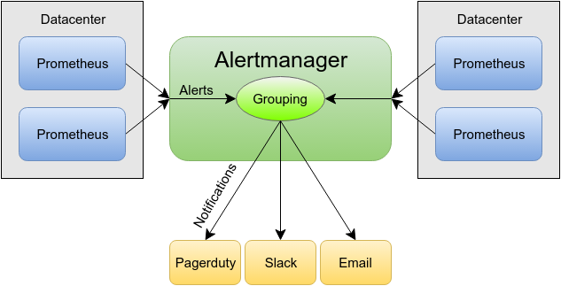
Alertmanager - Centralized Alert Handling in Prometheus
Alertmanager is a component of the Prometheus ecosystem
acts as the centralized alert handling system
Alerting Workflow with Webhooks
Alertmanager sends the processed alerts to external systems via Webhooks.

Slide 21
3.1
Issues & Solutions
Issue
Dependency on Docker Environment
But most server may not have docker environment
weak existing code quality
need robustness refractoring
Solution
Manual deployment using a .tar.gz archive
And complete refractoring of existing code

Slide 22
4
时间线与收获
Timeline & Gain

Slide 23

时间线
Timeline
NOV
DEC
Dynamic Cluster Refractor
Allow dynamic clusters
Deploy system onto test cluster
Working on user manual
Deploy Alertmanager
Use alertmanager to manage alerts
Add visualization in dashboard
Develop custom scripts
SEPT
OCT
Develop RBAC
Add permission control
Deploy Node Exporter
Allow custom alerting rules
Start working
Review exsiting code
Try to deploy on server
Fix bugs to make code runnable

Slide 24
4.1
Achievement
Deployed on test cluster and works well
Display alerts according our pre-defined rules
Monitor 3 computing nodes
Can be accessed in http://172.18.6.108/
can manage devices and clusters dynamic
be able to do the alert statisticis
also can manage permission and alerting rules

Slide 25
4.2
Gain
Deep understanding of Java web application developement
use a lot of framework and packages
Great knowledge of Prometheus monitoring and alerting system
Also components like Node Exporter and Alertmanager
Better ability of developing under Linux environment
more familiar with linux commands
Improved coorperation capability

Slide 26
THANK YOU

